Slide 1
Demystifying Debuggers
Dmitry Pogrebnoy
RubyMine Team Lead at JetBrains

Slide 2
What tools do we have to find bugs in Ruby code?
What technologies do Ruby debuggers use?
How do Ruby debuggers work?
Which debugger is the most performant?
How does the RubyMine debugger simplify debugging?

Slide 3
What tools do we have to find bugs in Ruby code?
What technologies do Ruby debuggers use?
How do Ruby debuggers work?
Which debugger is the most performant?
How does the RubyMine debugger simplify debugging?

Slide 4
What tools do we have to find bugs in Ruby code?
What technologies do Ruby debuggers use?
How do Ruby debuggers work?
Which debugger is the most performant?
How does the RubyMine debugger simplify debugging?

Slide 5
What tools do we have to find bugs in Ruby code?
What technologies do Ruby debuggers use?
How do Ruby debuggers work?
Which debugger is the most performant?
How does the RubyMine debugger simplify debugging?

Slide 6
What tools do we have to find bugs in Ruby code?
What technologies do Ruby debuggers use?
How do Ruby debuggers work?
Which debugger is the most performant?
How does the RubyMine debugger simplify debugging?

Slide 7
What tools do we have to find bugs in Ruby code?
What technologies do Ruby debuggers use?
How do Ruby debuggers work?
Which debugger is the most performant?
How does the RubyMine debugger simplify debugging?

Slide 8
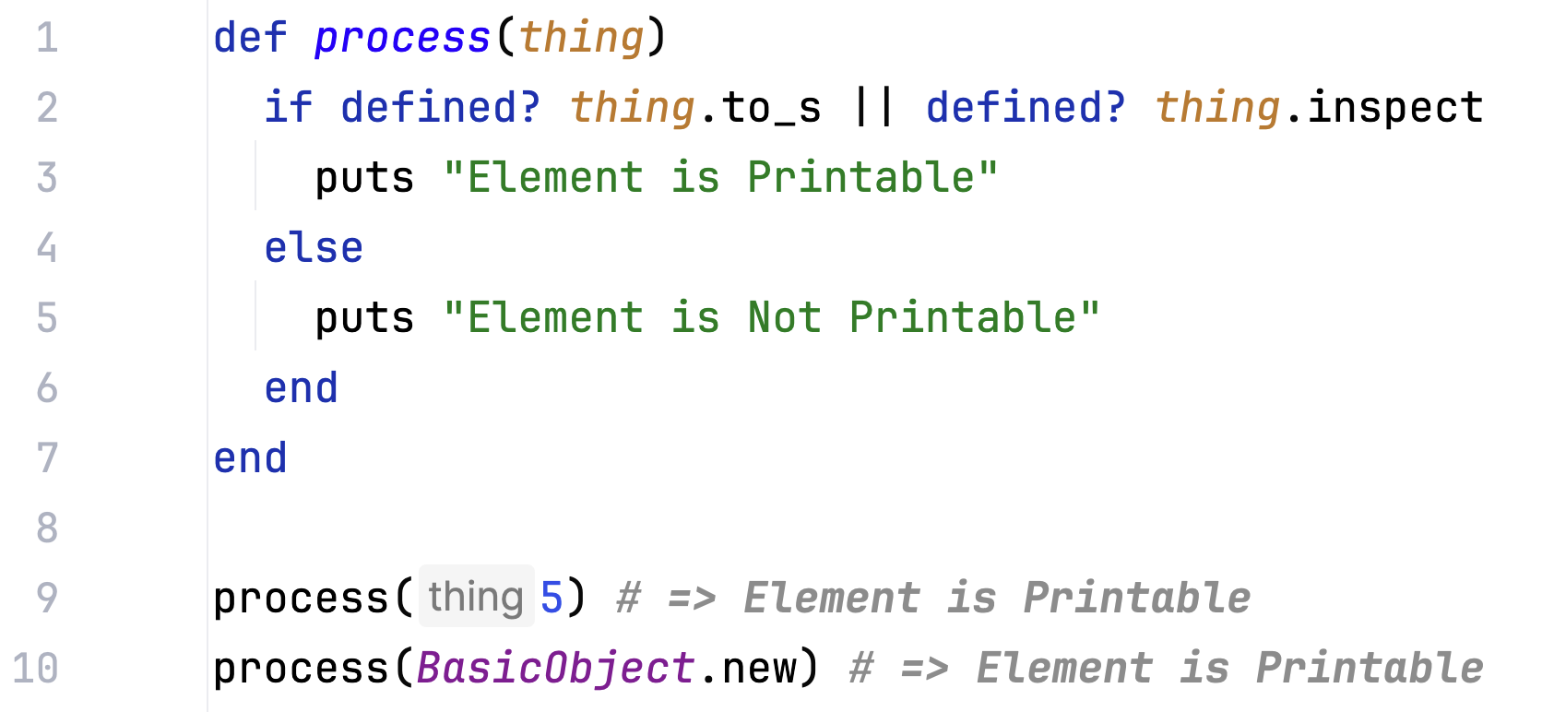
Let’s start with an example

Slide 9
Let’s start with an example

Slide 10
Let’s start with an example

Slide 11
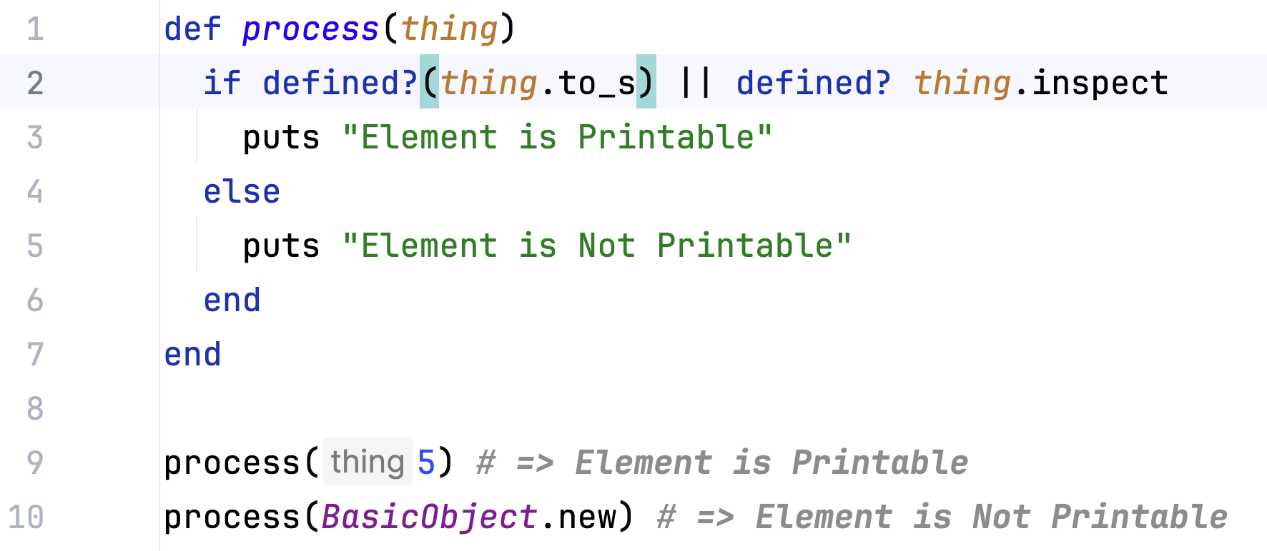
Let’s start with an example

Slide 12
Let’s start with an example

Slide 13
What tools could we use to find bugs?
puts statements
puts_debuggerer gem
awesome_print gem
Interactive consoles
IRB
Pry
Debuggers!

Slide 14
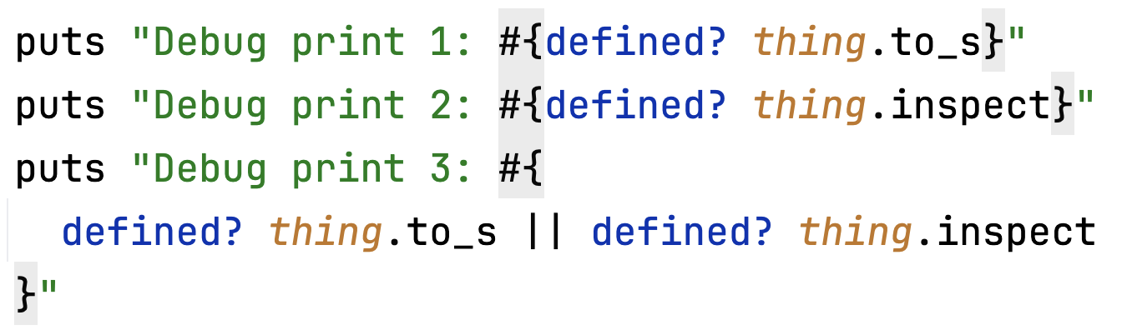
What tools could we use to find bugs?
puts statements
puts_debuggerer gem
awesome_print gem
Interactive consoles
IRB
Pry
Debuggers!

Slide 15
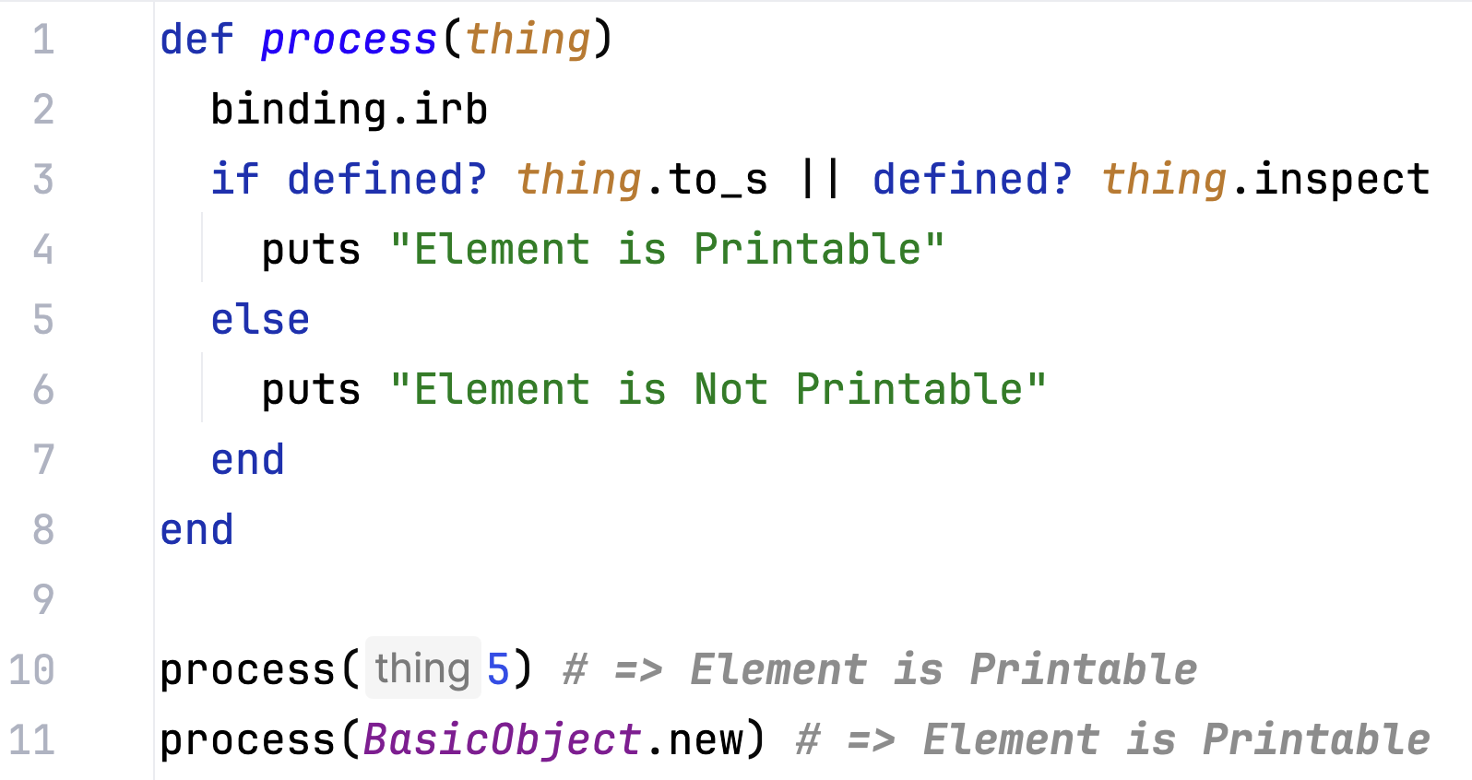
What tools could we use to find bugs?
puts statements
puts_debuggerer gem
awesome_print gem
Interactive consoles
IRB
Pry
Debuggers!

Slide 16
What tools could we use to find bugs?
puts statements
puts_debuggerer gem
awesome_print gem
Interactive consoles
IRB
Pry
Debuggers!

Slide 17
How often do Ruby developers use a debugger?

Slide 18

Every third run is a debug run!
Debug runs
Other runs
34%
66%
Based on anonymous stats from RubyMine 2024.2
Notes:
We need to strive to make it even better to increase productivity of our work and get things done with less resources.

Slide 19
What tools do we have to find bugs in Ruby code?
What technologies do Ruby debuggers use?
How do Ruby debuggers work?
Which debugger is the most performant?
How does the RubyMine debugger simplify debugging?

Slide 20
TracePoint
Introduced in Ruby 2.0
Allows to execute specific code on certain events in your code
Works everywhere except Ractor

Slide 21
TracePoint
Introduced in Ruby 2.0
Allows to execute specific code on certain events in your code
Works everywhere except Ractor

Slide 22
TracePoint
Introduced in Ruby 2.0
Allows to execute specific code on certain events in your code
Works everywhere except Ractor

Slide 23
TracePoint
Introduced in Ruby 2.0
Allows to execute specific code on certain events in your code
Works everywhere except Ractor

Slide 24
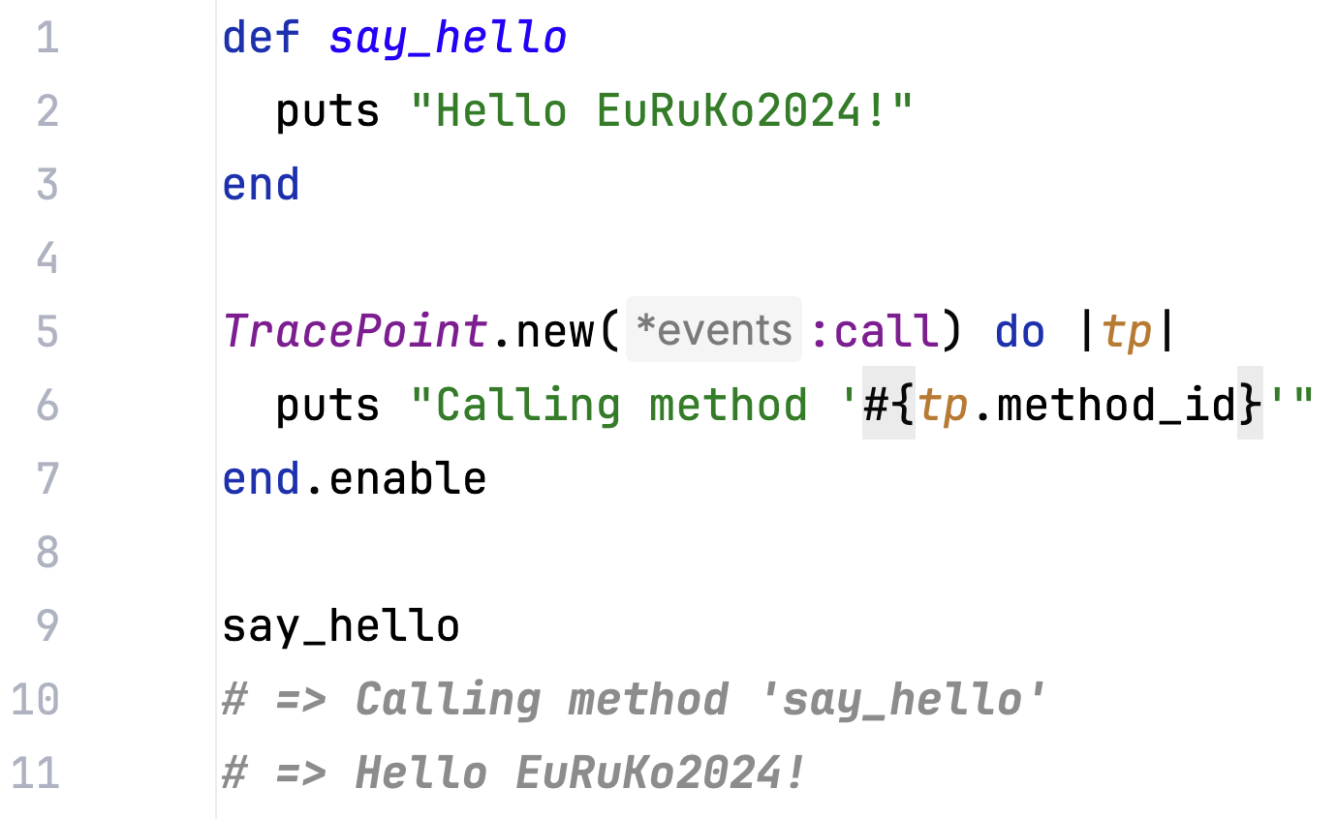
TracePoint example

Slide 25
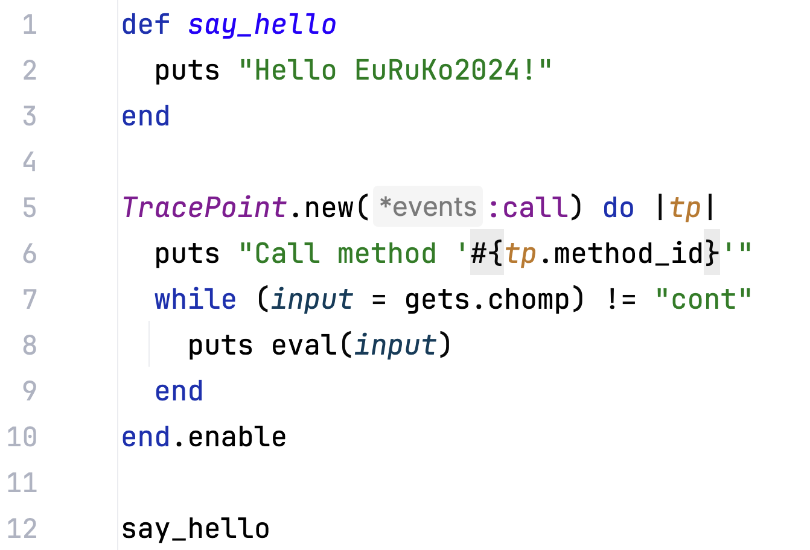
Debugger with TracePoint

Slide 26
Debugger with TracePoint

Slide 27
Ruby VM Instruction Sequence

Slide 28
Instruction Sequence – ISeq
Representation of compiled bytecode for a Ruby VM
Depends on the Ruby version
Provides access to low-level representation of Ruby code

Slide 29
Instruction Sequence – ISeq
Representation of compiled bytecode for a Ruby VM
Depends on the Ruby version
Provides access to low-level representation of Ruby code

Slide 30
Instruction Sequence – ISeq
Representation of compiled bytecode for a Ruby VM
Depends on the Ruby version
Provides access to low-level representation of Ruby code
Notes:
Using Instruction Sequence, you can modify bytecode and adjust the behaviour of your program without touching the source code in Ruby.

Slide 31
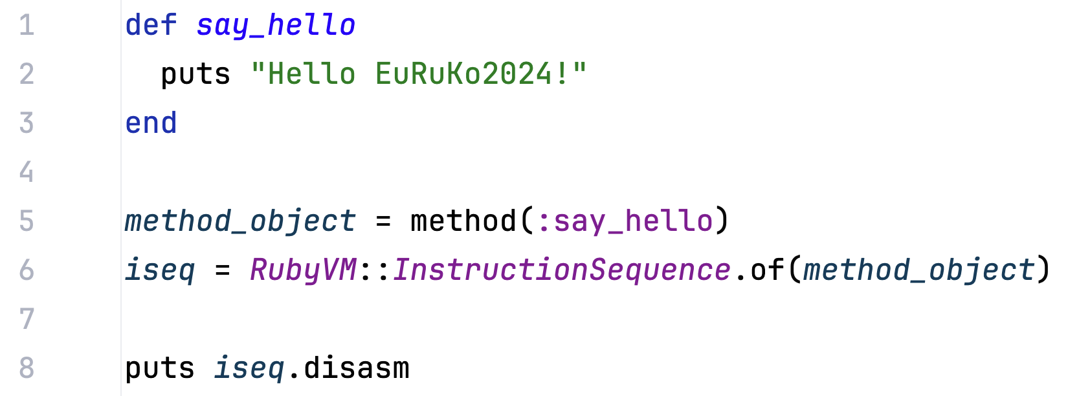
Instruction Sequence example

Slide 32
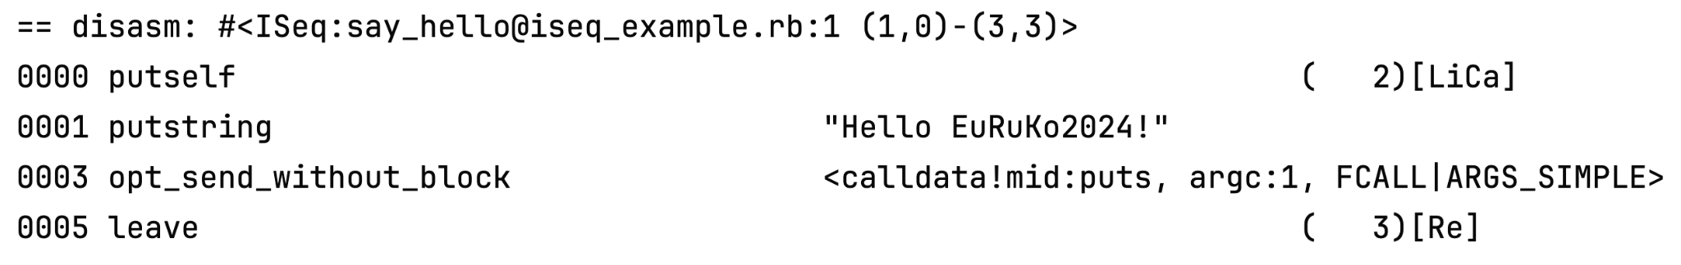
Instruction Sequence example

Slide 33
Instruction Sequence example

Slide 34
Instruction Sequence example

Slide 35
What tools do we have to find bugs in Ruby code?
What technologies do Ruby debuggers use?
How do Ruby debuggers work?
Which debugger is the most performant?
How does the RubyMine debugger simplify debugging?

Slide 36
Byebug
Provides breakpoints, stepping, and context introspection
Default debugger for
Ruby 2.5.X - 2.6.X
Rails 5.X - 6.X
Requires modification to source code for debugging
CLI and VS Code plugin for GUI

Slide 37
Byebug
Provides breakpoints, stepping, and context introspection
Default debugger for
Ruby 2.5.X - 2.6.X
Rails 5.X - 6.X
Requires modification to source code for debugging
CLI and VS Code plugin for GUI

Slide 38
Byebug
Provides breakpoints, stepping, and context introspection
Default debugger for
Ruby 2.5.X - 2.6.X
Rails 5.X - 6.X
Requires modification to source code for debugging
CLI and VS Code plugin for GUI

Slide 39
Byebug
Provides breakpoints, stepping, and context introspection
Default debugger for
Ruby 2.5.X - 2.6.X
Rails 5.X - 6.X
Requires modification to source code for debugging
CLI and VS Code plugin for GUI

Slide 40
Byebug
Provides breakpoints, stepping, and context introspection
Default debugger for
Ruby 2.5.X - 2.6.X
Rails 5.X - 6.X
Requires modification to source code for debugging
CLI and VS Code plugin for GUI

Slide 41
How does Byebug work?

Slide 42
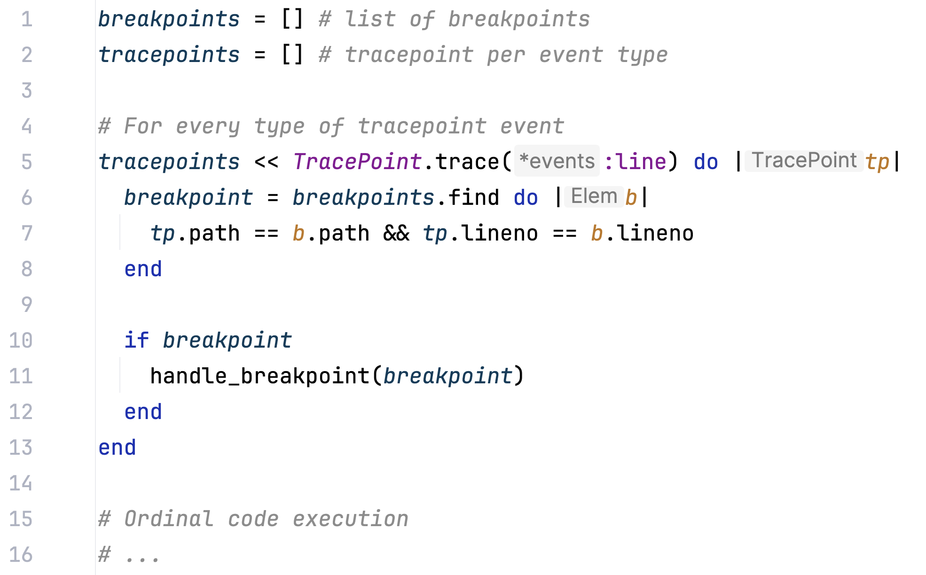
Simple model of Byebug

Slide 43
Simple model of Byebug

Slide 44
Simple model of Byebug

Slide 45
Simple model of Byebug
🐌

Slide 46
Debug gem

Slide 47
TracePoint improvements
TracePoint improvements in Ruby 2.6
Ability to specify target line or iseq for TracePoint
No need to check every event -> no performance degradation

Slide 48
TracePoint improvements
TracePoint improvements in Ruby 2.6
Ability to specify target line or iseq for TracePoint
No need to check every event -> no performance degradation

Slide 49
TracePoint improvements
TracePoint improvements in Ruby 2.6
Ability to specify target line or iseq for TracePoint
No need to check every event -> no performance degradation
🚀

Slide 50
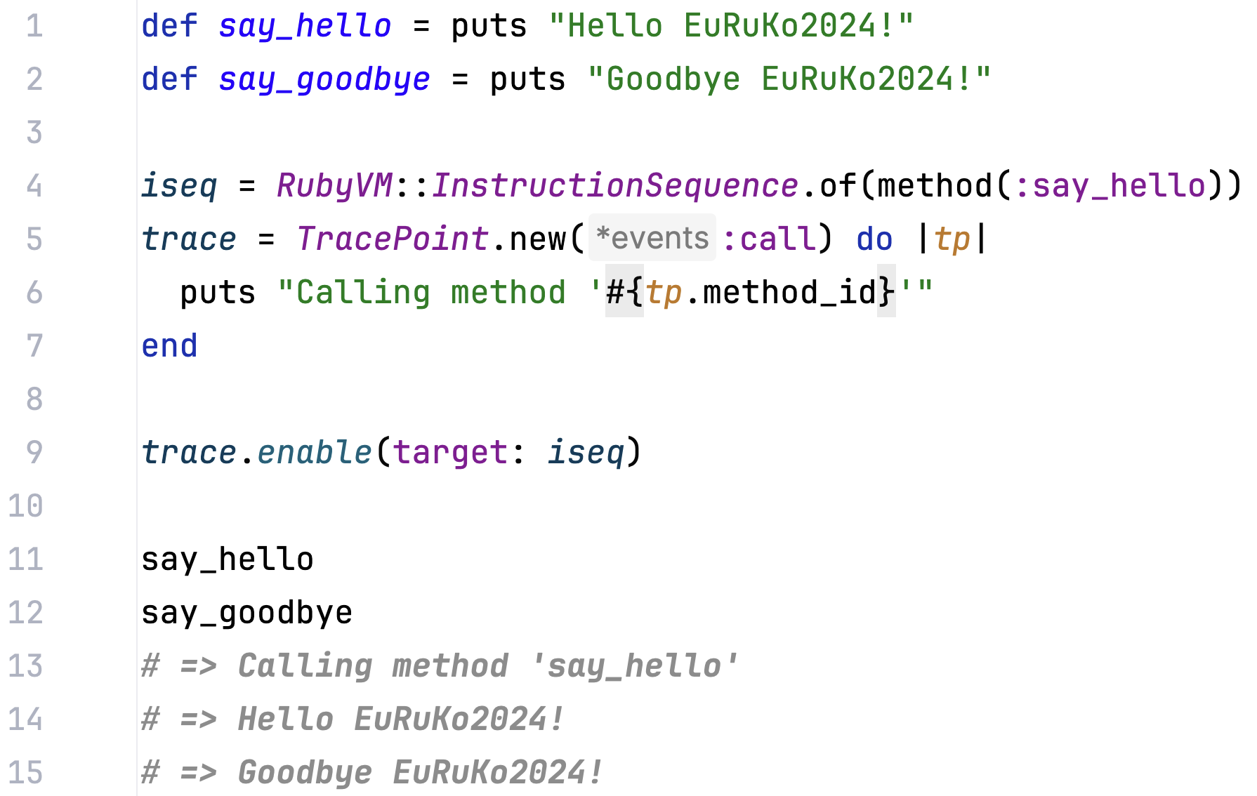
TracePoint improvement example

Slide 51
TracePoint improvement example

Slide 52
TracePoint improvement example

Slide 53
Debug gem
No performance degradation
Supports Ruby 2.7+
Supports different frontends – VS Code and Chrome
Bundled in Ruby 3.1+

Slide 54
Debug gem
No performance degradation
Supports Ruby 2.7+
Supports different frontends – VS Code and Chrome
Bundled in Ruby 3.1+

Slide 55
Debug gem
No performance degradation
Supports Ruby 2.7+
Supports different frontends – VS Code and Chrome
Bundled in Ruby 3.1+

Slide 56
Debug gem
No performance degradation
Supports Ruby 2.7+
Supports different frontends – VS Code and Chrome
Bundled in Ruby 3.1+

Slide 57
RubyMine debugger

Slide 58
RubyMine debugger
Bundled in RubyMine with GUI
Seamless debugging experience
Supports Ruby 2.3+
No performance degradation with all supported Ruby versions
Ability to attach to any Ruby process

Slide 59
RubyMine debugger
Bundled in RubyMine with GUI
Seamless debugging experience
Supports Ruby 2.3+
No performance degradation with all supported Ruby versions
Ability to attach to any Ruby process

Slide 60
RubyMine debugger
Bundled in RubyMine with GUI
Seamless debugging experience
Supports Ruby 2.3+
No performance degradation with all supported Ruby versions
Ability to attach to any Ruby process

Slide 61
RubyMine debugger
Bundled in RubyMine with GUI
Seamless debugging experience
Supports Ruby 2.3+
No performance degradation with all supported Ruby versions
Ability to attach to any Ruby process

Slide 62
RubyMine debugger
Bundled in RubyMine with GUI
Seamless debugging experience
Supports Ruby 2.3+
No performance degradation with all supported Ruby versions
Ability to attach to any Ruby process

Slide 63
How is the RubyMine debugger structured?

Slide 64
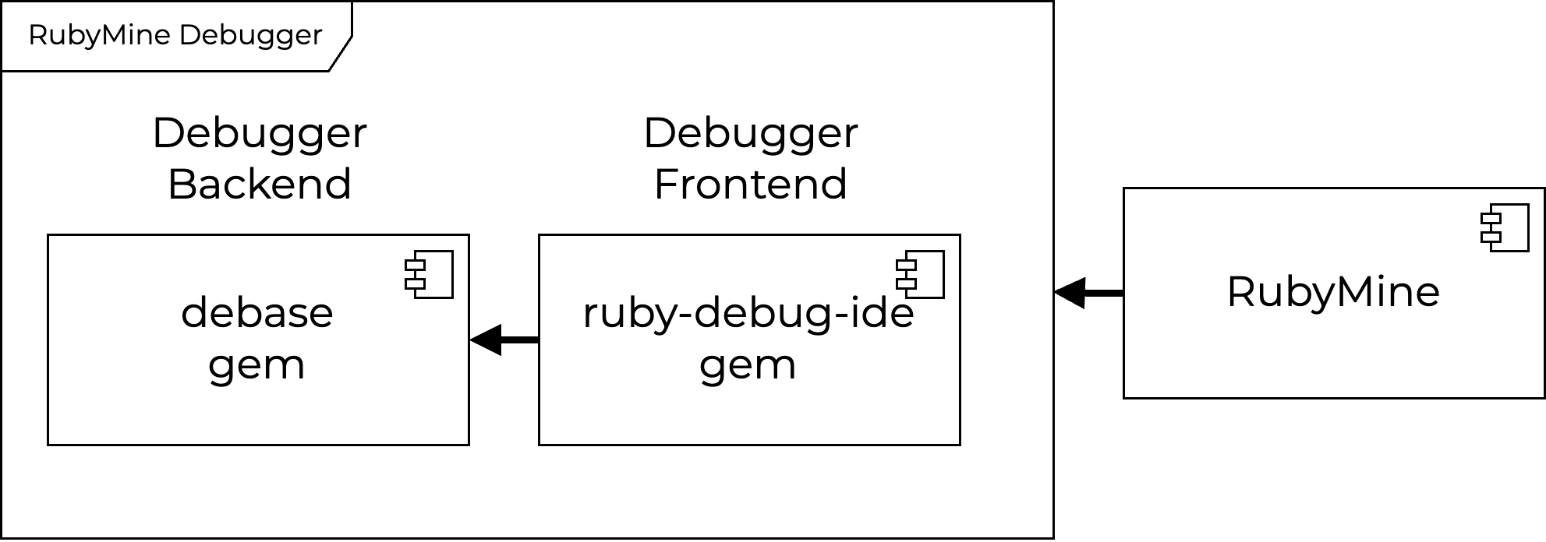
RubyMine debugger architecture

Slide 65
RubyMine debugger architecture
Notes:
It is responsible for iseqs, frames and context retrieving.

Slide 66
RubyMine debugger architecture

Slide 67
RubyMine debugger architecture

Slide 68
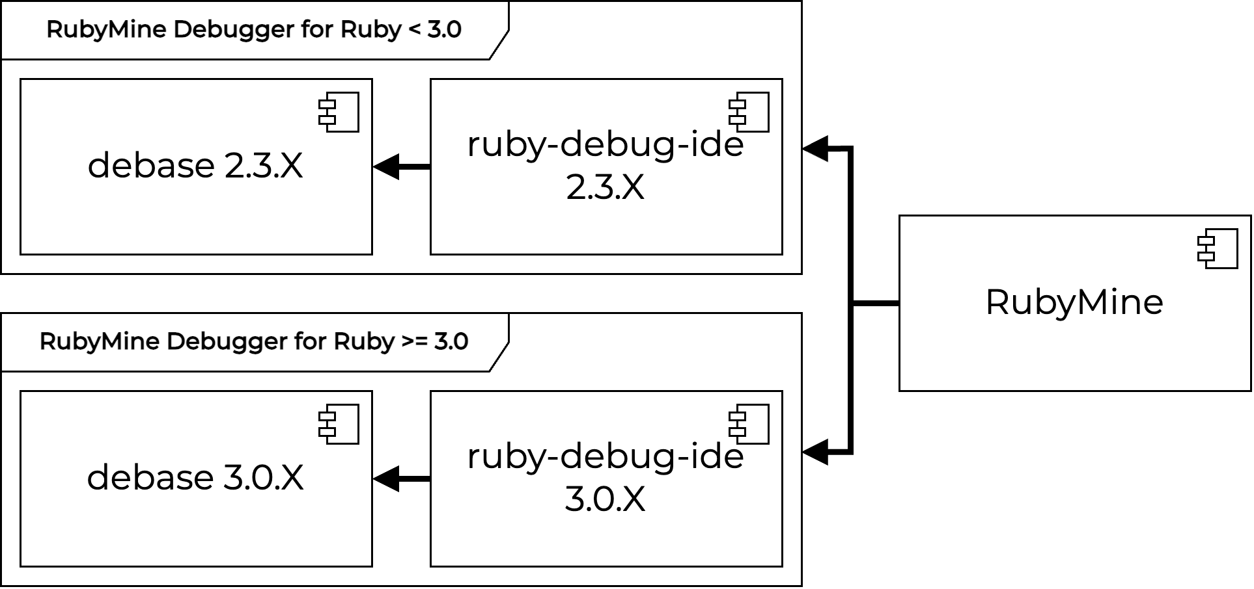
RubyMine debugger architecture

Slide 69
RubyMine debugger architecture

Slide 70
RubyMine debugger architecture

Slide 71
How does RubyMine connect to
the debugger?

Slide 72
RM debugger connection process
RubyMine
Main debug process
Child debug process
Starts main process

Slide 73
RM debugger connection process
RubyMine
Main debug process
Child debug process
Starts main process
Connects using default port

Slide 74
RM debugger connection process
RubyMine
Main debug process
Child debug process
Starts main process
Connects using default port
Starts child process

Slide 75
RM debugger connection process
RubyMine
Main debug process
Child debug process
Starts main process
Connects using default port
Starts child process
Sends new connection port

Slide 76
RM debugger connection process
RubyMine
Main debug process
Child debug process
Starts main process
Connects using default port
Starts child process
Sends new connection port
Connects using new port

Slide 77
What tools do we have to find bugs in Ruby code?
What technologies do Ruby debuggers use?
How do Ruby debuggers work?
Which debugger is the most performant?
How does the RubyMine debugger simplify debugging?

Slide 78
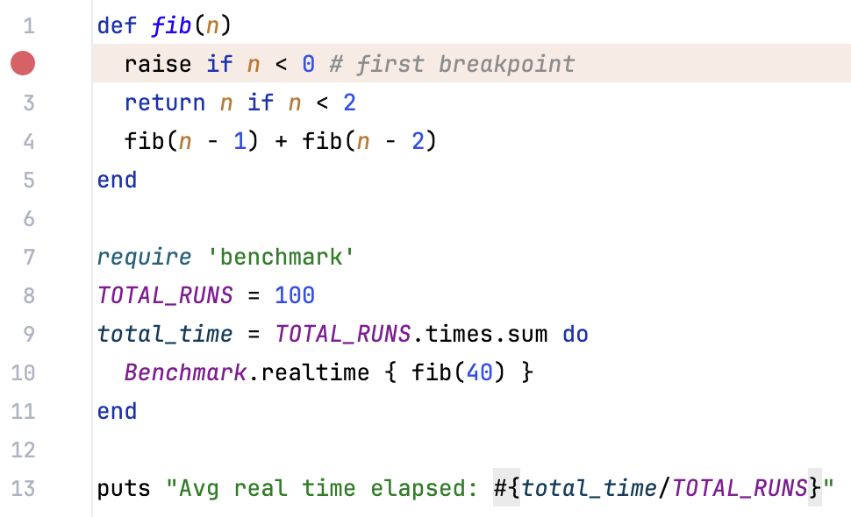
Performance methodology

Slide 79
Debugger versions
Byebug version – 11.1.3
Debug gem version – 1.9.2
RubyMine debugger for Ruby 3.3.3
ruby-debug-ide – 3.0.0.beta.17
debase – 3.0.0.beta.11
RubyMine debugger for Ruby 2.6.10
ruby-debug-ide – 2.3.20
debase – 2.3.14

Slide 80
Debugger performance
 | Ruby 2.6.10 | Ruby 3.3.3
Basic run | 17.7 sec | 15.8 sec
Byebug | 529.1 sec
Debug gem |  | 15.8 sec
RubyMine debugger | 17.7 sec | 15.8 sec

Slide 81
Debugger performance
 | Ruby 2.6.10 | Ruby 3.3.3
Basic run | 17.7 sec | 15.8 sec
Byebug | 529.1 sec
Debug gem |  | 15.8 sec
RubyMine debugger | 17.7 sec | 15.8 sec

Slide 82
Debugger performance
 | Ruby 2.6.10 | Ruby 3.3.3
Basic run | 17.7 sec | 15.8 sec
Byebug | 529.1 sec
Debug gem |  | 15.8 sec
RubyMine debugger | 17.7 sec | 15.8 sec

Slide 83
Debugger performance
 | Ruby 2.6.10 | Ruby 3.3.3
Basic run | 17.7 sec | 15.8 sec
Byebug | 529.1 sec
Debug gem |  | 15.8 sec
RubyMine debugger | 17.7 sec | 15.8 sec
Notes:
To insert or delete rows or columns, right-click the table.
Line thickness is 2 px. Text alignment is centered.
To keep the template design consistent, please paste text from another source using Paste without formatting (right-click or menu Edit).

Slide 84
What tools do we have to find bugs in Ruby code?
What technologies do Ruby debuggers use?
How do Ruby debuggers work?
Which debugger is the most performant?
How does the RubyMine debugger simplify debugging?

Slide 85
Debug Rails applications in one click

Slide 86
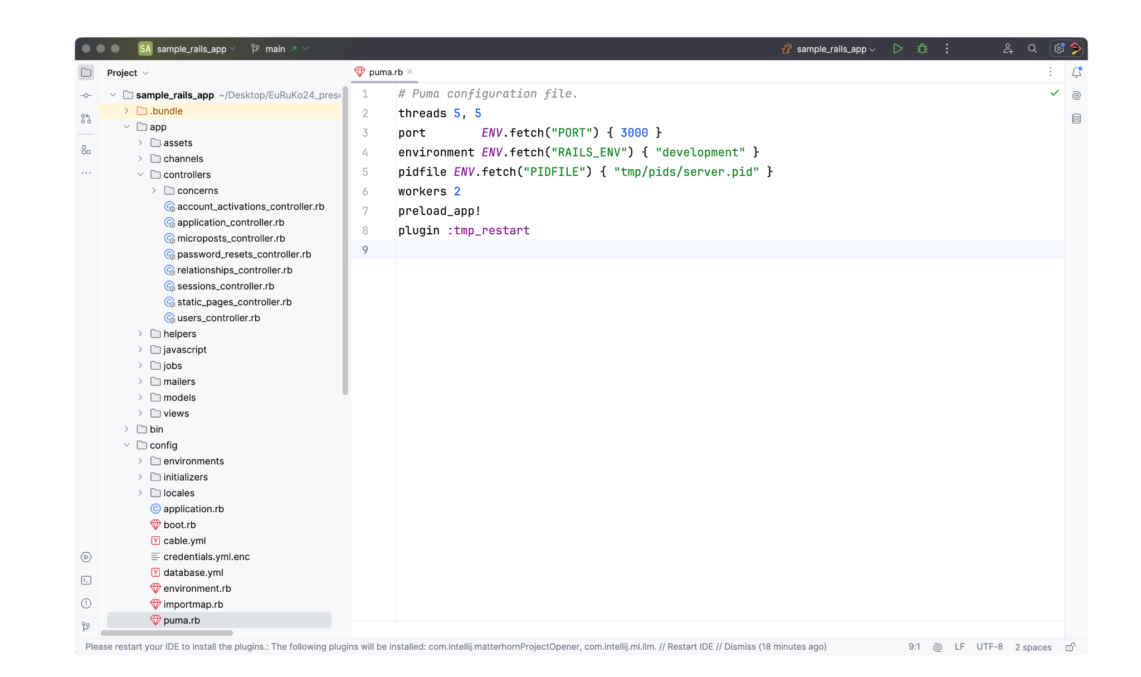

Slide 88
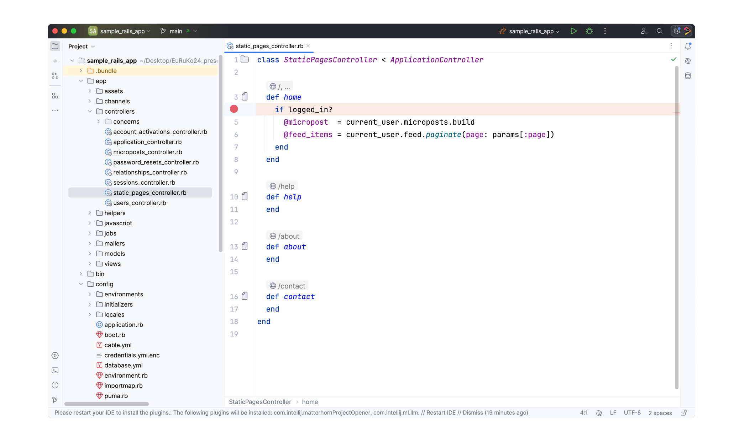

Slide 90
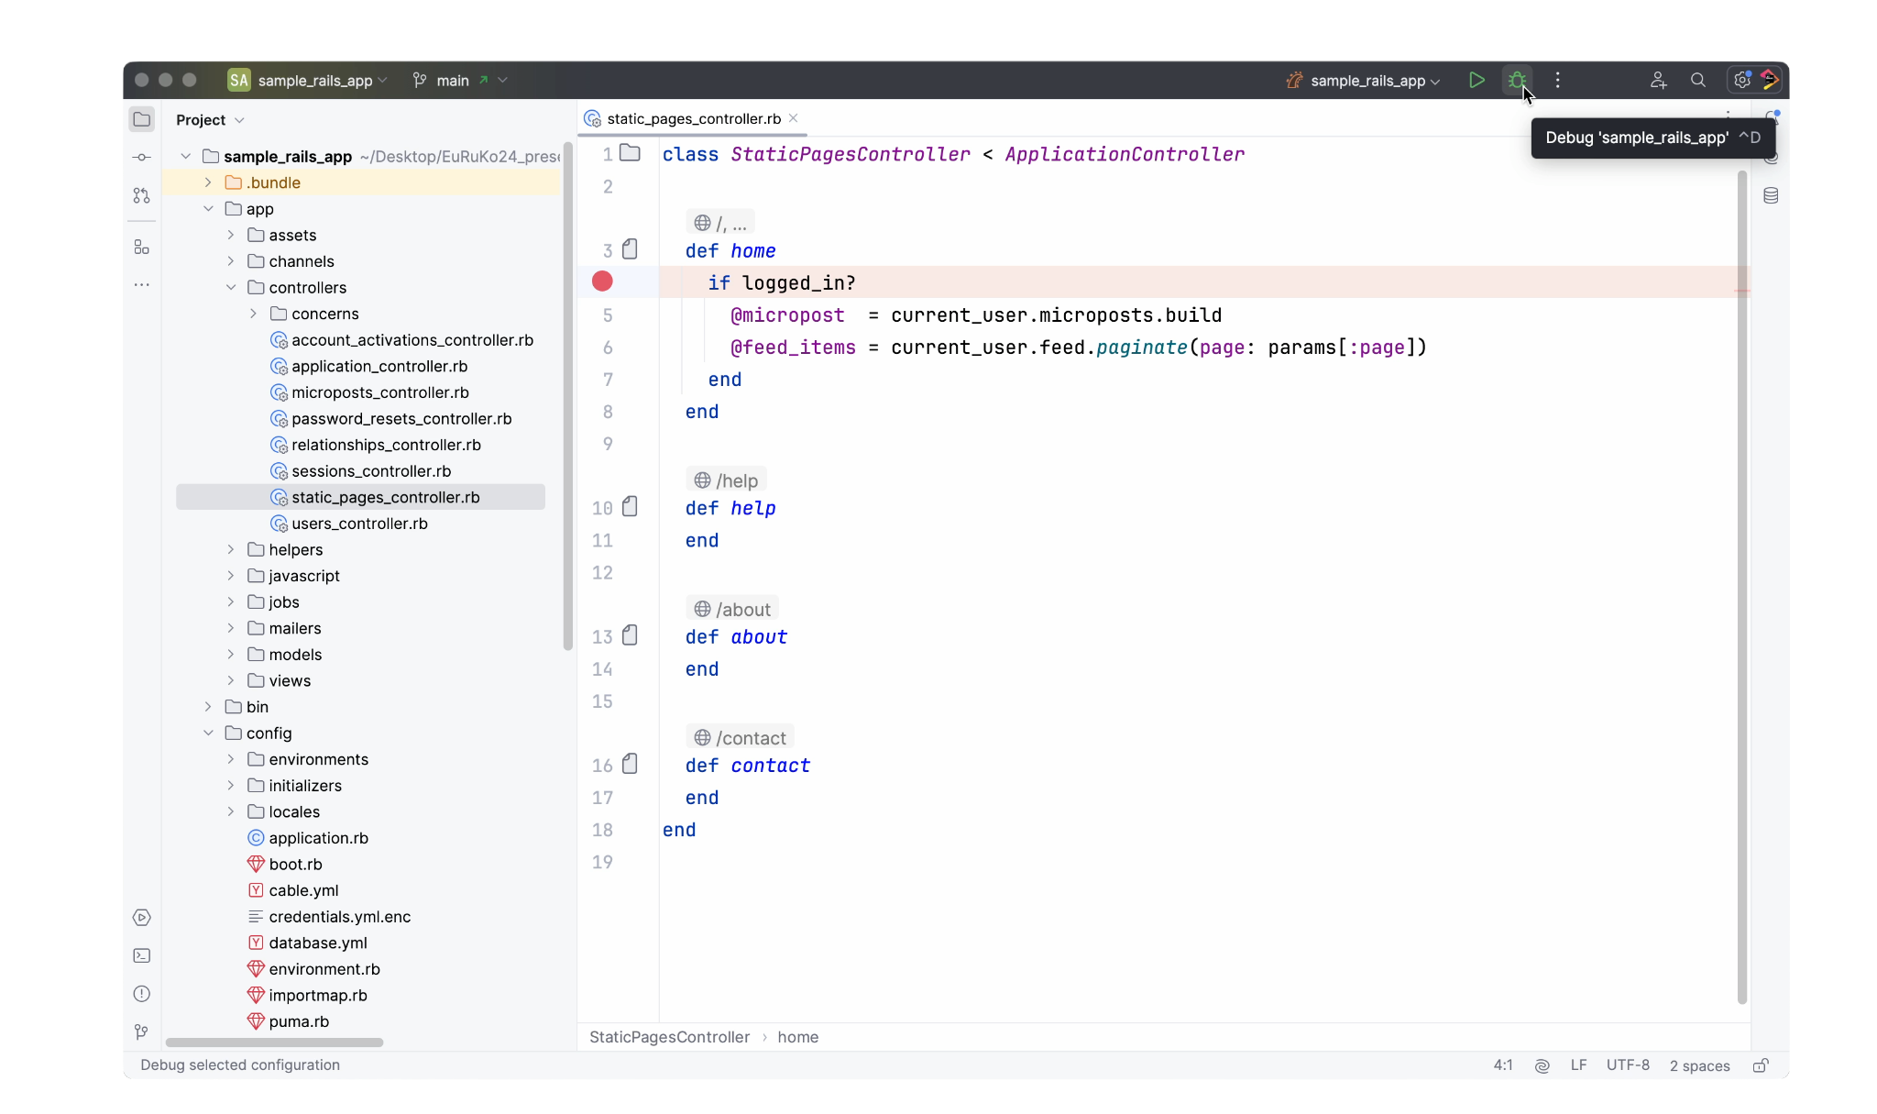

Slide 91
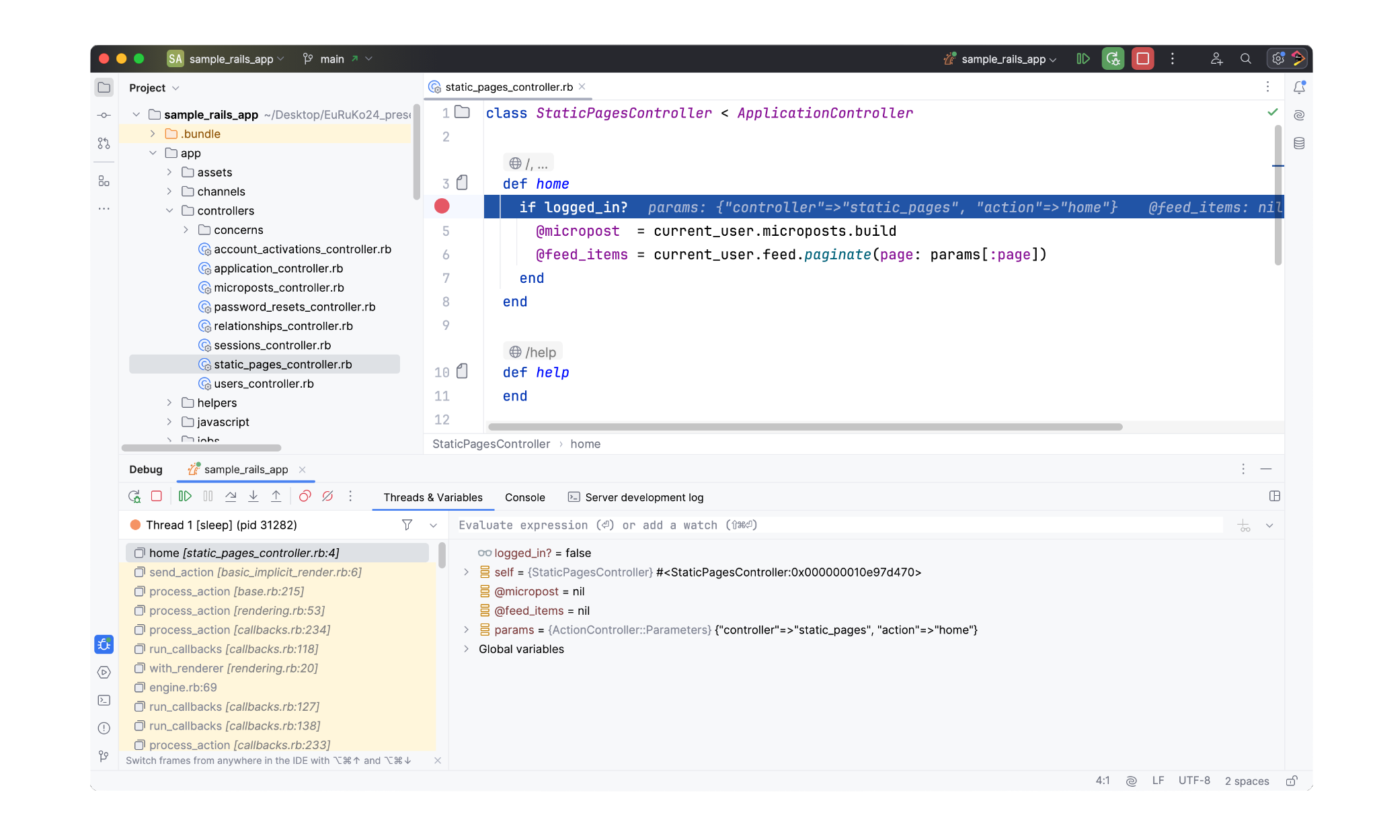

Slide 92
Inline debugger values

Slide 93
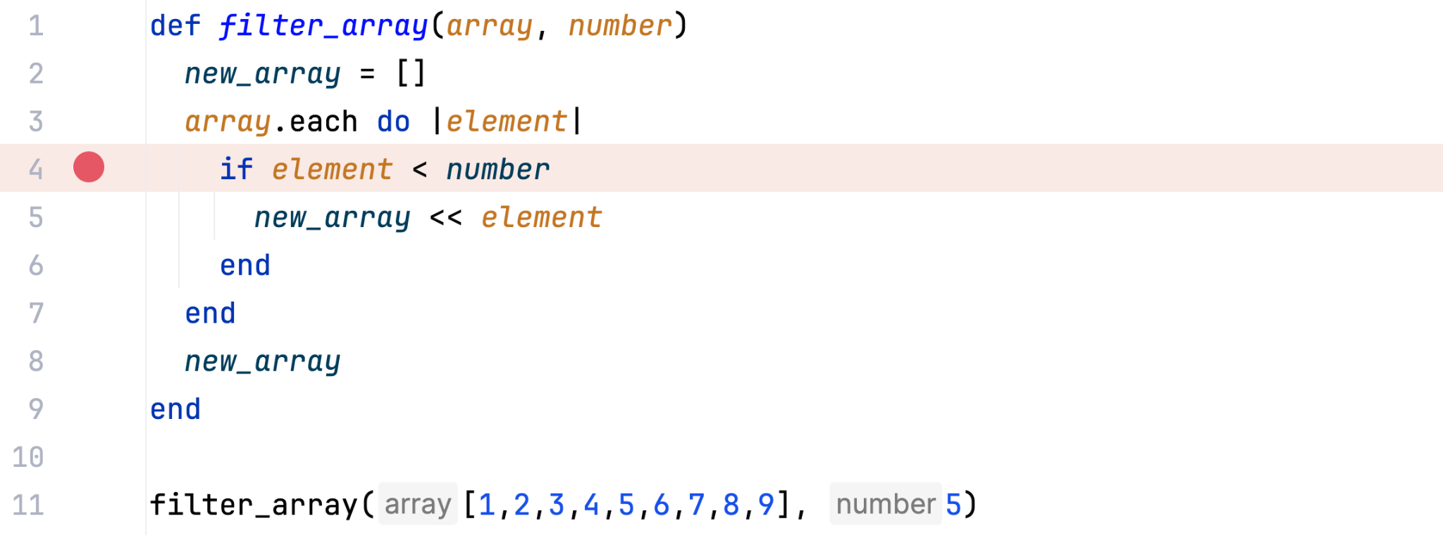
Inline debugger values

Slide 94
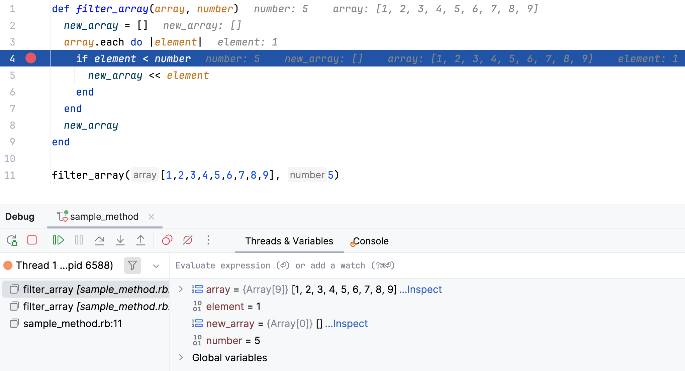
Inline debugger values

Slide 95
Inline debugger values

Slide 96
Inline debugger values

Slide 97
Key points
Ruby debuggers use
TracePoint
Instruction Sequence
Debug gem works fast due to TracePoint improvements
RubyMine debugger
Works fast with all supported Ruby versions
Enables on-click debugging for Rails applications
Provides inline debugger values to help you debug
Notes:
So to recap, firstly I would like to …

Slide 98
Key points
Ruby debuggers use
TracePoint
Instruction Sequence
Debug gem works fast due to TracePoint improvements
RubyMine debugger
Works fast with all supported Ruby versions
Enables on-click debugging for Rails applications
Provides inline debugger values to help you debug

Slide 99
Key points
Ruby debuggers use
TracePoint
Instruction Sequence
Debug gem works fast due to TracePoint improvements
RubyMine debugger
Works fast with all supported Ruby versions
Enables on-click debugging for Rails applications
Provides inline debugger values to help you debug

Slide 100
Key points
Ruby debuggers use
TracePoint
Instruction Sequence
Debug gem works fast due to TracePoint improvements
RubyMine debugger
Works fast with all supported Ruby versions
Enables on-click debugging for Rails applications
Provides inline debugger values to help you debug

Slide 101


Thank you!
Share your RubyMine experience with me on LinkedIn!
Dmitry Pogrebnoy
RubyMine Team Lead at JetBrains

Slide 102
How to find a bug with other tools?
Notes:
This slide is intended to draw attention to the speaker’s words and not distract the audience with detailed reading material.
To keep the template design consistent, please paste text from another source using Paste without formatting (right-click or menu Edit).

Slide 103
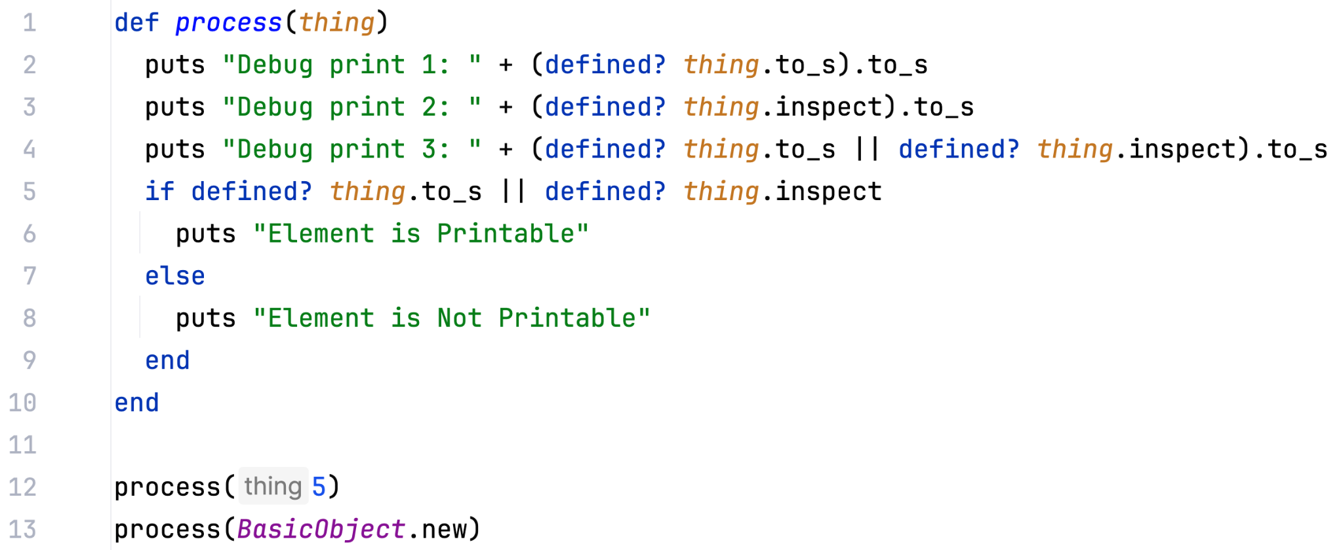
Puts
Notes:
This is a Picture with header and text slide that’s ideal for including picture with caption or brief descriptive statement.
To place the picture on this slide (this applies to all slides in this template that contain picture placeholders):
Click the white circle in the middle of the picture placeholder and select the insert option that best suits your needs.
Use the Crop tool to reposition the picture within the placeholder:
Right-click the picture placeholder, select Crop image. Click and drag the picture within the placeholder to reposition it.
To scale the picture within the placeholder (while Crop is active), grab a corner handle and drag it.
To keep the template design consistent, please paste text from another source using Paste without formatting (right-click or menu Edit).
Please take note that presentations are intended to help the audience focus on the speaker’s words rather than distract them with detailed reading material.
Each slide should use only a handful of words to reiterate the speaker's points, using imagery and text that reinforce the speaker’s point.
Avoid inserting so much text that you have to decrease the font size.

Slide 104
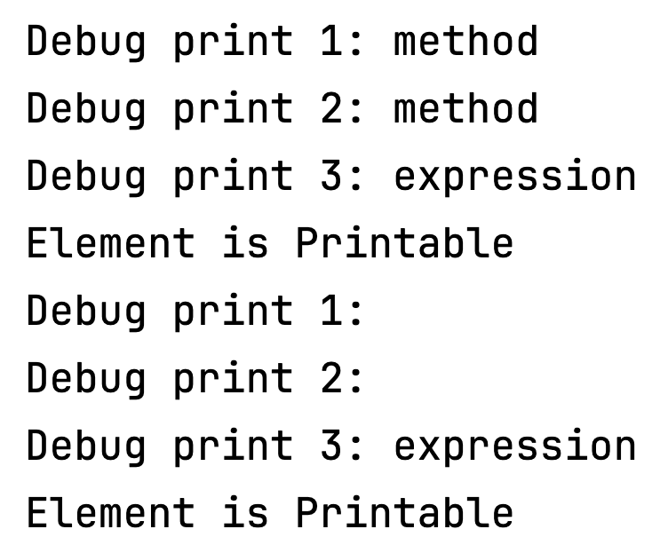
Puts output
Notes:
This is a Picture with header and text slide that’s ideal for including picture with caption or brief descriptive statement.
To place the picture on this slide (this applies to all slides in this template that contain picture placeholders):
Click the white circle in the middle of the picture placeholder and select the insert option that best suits your needs.
Use the Crop tool to reposition the picture within the placeholder:
Right-click the picture placeholder, select Crop image. Click and drag the picture within the placeholder to reposition it.
To scale the picture within the placeholder (while Crop is active), grab a corner handle and drag it.
To keep the template design consistent, please paste text from another source using Paste without formatting (right-click or menu Edit).
Please take note that presentations are intended to help the audience focus on the speaker’s words rather than distract them with detailed reading material.
Each slide should use only a handful of words to reiterate the speaker's points, using imagery and text that reinforce the speaker’s point.
Avoid inserting so much text that you have to decrease the font size.

Slide 105
Ruby Interactive Console
Notes:
This slide is intended to draw attention to the speaker’s words and not distract the audience with detailed reading material.
To keep the template design consistent, please paste text from another source using Paste without formatting (right-click or menu Edit).

Slide 106
IRB Console
Notes:
This is a Picture with header and text slide that’s ideal for including picture with caption or brief descriptive statement.
To place the picture on this slide (this applies to all slides in this template that contain picture placeholders):
Click the white circle in the middle of the picture placeholder and select the insert option that best suits your needs.
Use the Crop tool to reposition the picture within the placeholder:
Right-click the picture placeholder, select Crop image. Click and drag the picture within the placeholder to reposition it.
To scale the picture within the placeholder (while Crop is active), grab a corner handle and drag it.
To keep the template design consistent, please paste text from another source using Paste without formatting (right-click or menu Edit).
Please take note that presentations are intended to help the audience focus on the speaker’s words rather than distract them with detailed reading material.
Each slide should use only a handful of words to reiterate the speaker's points, using imagery and text that reinforce the speaker’s point.
Avoid inserting so much text that you have to decrease the font size.

Slide 107
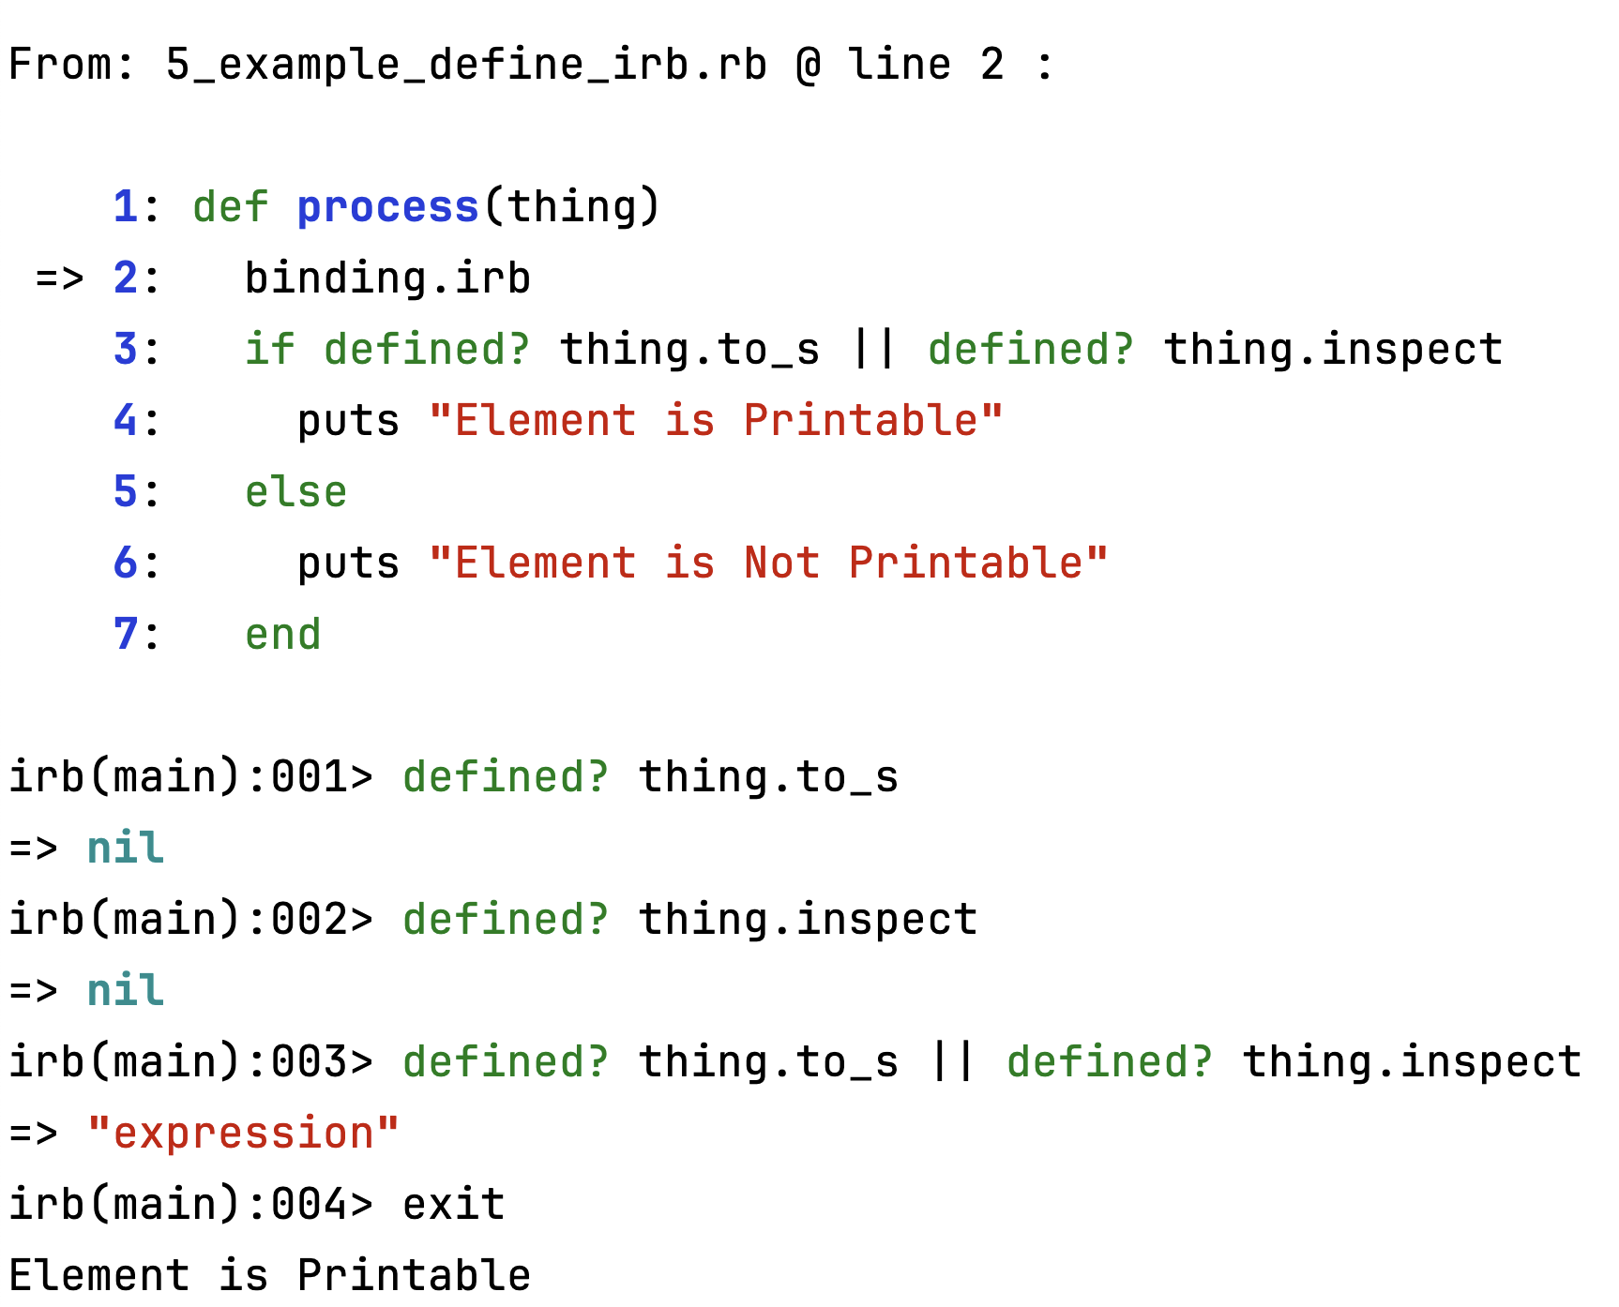
IRB Console
Notes:
This is a Picture with header and text slide that’s ideal for including picture with caption or brief descriptive statement.
To place the picture on this slide (this applies to all slides in this template that contain picture placeholders):
Click the white circle in the middle of the picture placeholder and select the insert option that best suits your needs.
Use the Crop tool to reposition the picture within the placeholder:
Right-click the picture placeholder, select Crop image. Click and drag the picture within the placeholder to reposition it.
To scale the picture within the placeholder (while Crop is active), grab a corner handle and drag it.
To keep the template design consistent, please paste text from another source using Paste without formatting (right-click or menu Edit).
Please take note that presentations are intended to help the audience focus on the speaker’s words rather than distract them with detailed reading material.
Each slide should use only a handful of words to reiterate the speaker's points, using imagery and text that reinforce the speaker’s point.
Avoid inserting so much text that you have to decrease the font size.

Slide 108
RubyMine Debugger message protocol
Notes:
This slide is intended to draw attention to the speaker’s words and not distract the audience with detailed reading material.
To keep the template design consistent, please paste text from another source using Paste without formatting (right-click or menu Edit).

Slide 109
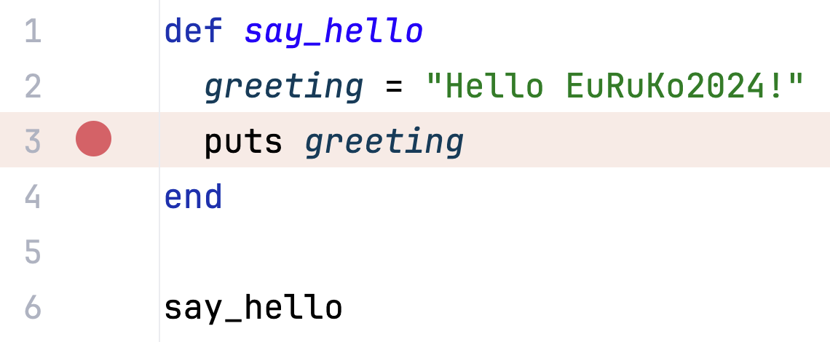
RM Debugger message protocol
Setting -> Build, Execution, Deployment -> Debugger -> Ruby -> Verbose debugger output
Notes:
This is a Picture with header and text slide that’s ideal for including picture with caption or brief descriptive statement.
To place the picture on this slide (this applies to all slides in this template that contain picture placeholders):
Click the white circle in the middle of the picture placeholder and select the insert option that best suits your needs.
Use the Crop tool to reposition the picture within the placeholder:
Right-click the picture placeholder, select Crop image. Click and drag the picture within the placeholder to reposition it.
To scale the picture within the placeholder (while Crop is active), grab a corner handle and drag it.
To keep the template design consistent, please paste text from another source using Paste without formatting (right-click or menu Edit).
Please take note that presentations are intended to help the audience focus on the speaker’s words rather than distract them with detailed reading material.
Each slide should use only a handful of words to reiterate the speaker's points, using imagery and text that reinforce the speaker’s point.
Avoid inserting so much text that you have to decrease the font size.

Slide 110
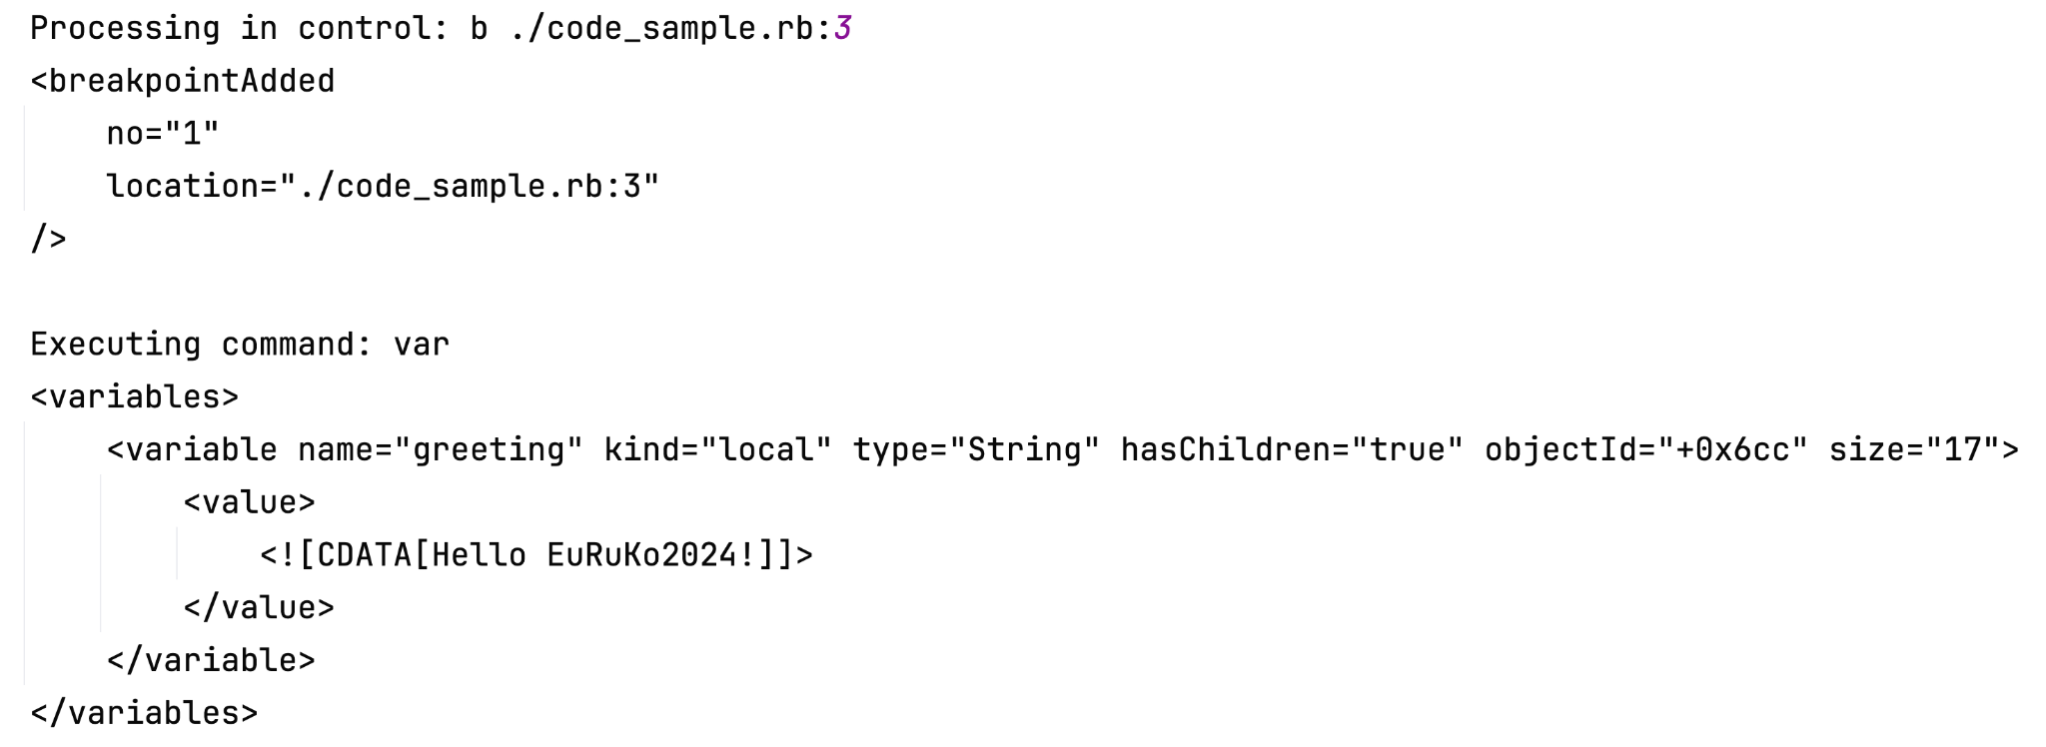
RM Debugger message protocol
Notes:
This is a Picture with header and text slide that’s ideal for including picture with caption or brief descriptive statement.
To place the picture on this slide (this applies to all slides in this template that contain picture placeholders):
Click the white circle in the middle of the picture placeholder and select the insert option that best suits your needs.
Use the Crop tool to reposition the picture within the placeholder:
Right-click the picture placeholder, select Crop image. Click and drag the picture within the placeholder to reposition it.
To scale the picture within the placeholder (while Crop is active), grab a corner handle and drag it.
To keep the template design consistent, please paste text from another source using Paste without formatting (right-click or menu Edit).
Please take note that presentations are intended to help the audience focus on the speaker’s words rather than distract them with detailed reading material.
Each slide should use only a handful of words to reiterate the speaker's points, using imagery and text that reinforce the speaker’s point.
Avoid inserting so much text that you have to decrease the font size.

Slide 111
RM Debugger message protocol
Notes:
This is a Picture with header and text slide that’s ideal for including picture with caption or brief descriptive statement.
To place the picture on this slide (this applies to all slides in this template that contain picture placeholders):
Click the white circle in the middle of the picture placeholder and select the insert option that best suits your needs.
Use the Crop tool to reposition the picture within the placeholder:
Right-click the picture placeholder, select Crop image. Click and drag the picture within the placeholder to reposition it.
To scale the picture within the placeholder (while Crop is active), grab a corner handle and drag it.
To keep the template design consistent, please paste text from another source using Paste without formatting (right-click or menu Edit).
Please take note that presentations are intended to help the audience focus on the speaker’s words rather than distract them with detailed reading material.
Each slide should use only a handful of words to reiterate the speaker's points, using imagery and text that reinforce the speaker’s point.
Avoid inserting so much text that you have to decrease the font size.

Slide 112
RM Debugger message protocol
Notes:
This is a Picture with header and text slide that’s ideal for including picture with caption or brief descriptive statement.
To place the picture on this slide (this applies to all slides in this template that contain picture placeholders):
Click the white circle in the middle of the picture placeholder and select the insert option that best suits your needs.
Use the Crop tool to reposition the picture within the placeholder:
Right-click the picture placeholder, select Crop image. Click and drag the picture within the placeholder to reposition it.
To scale the picture within the placeholder (while Crop is active), grab a corner handle and drag it.
To keep the template design consistent, please paste text from another source using Paste without formatting (right-click or menu Edit).
Please take note that presentations are intended to help the audience focus on the speaker’s words rather than distract them with detailed reading material.
Each slide should use only a handful of words to reiterate the speaker's points, using imagery and text that reinforce the speaker’s point.
Avoid inserting so much text that you have to decrease the font size.

Slide 113
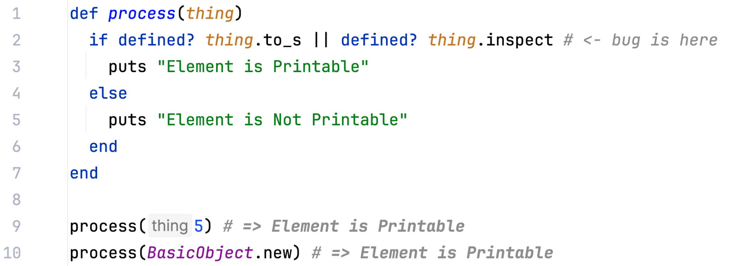
Logging Breakpoint
Notes:
This is a Picture with header and text slide that’s ideal for including picture with caption or brief descriptive statement.
To place the picture on this slide (this applies to all slides in this template that contain picture placeholders):
Click the white circle in the middle of the picture placeholder and select the insert option that best suits your needs.
Use the Crop tool to reposition the picture within the placeholder:
Right-click the picture placeholder, select Crop image. Click and drag the picture within the placeholder to reposition it.
To scale the picture within the placeholder (while Crop is active), grab a corner handle and drag it.
To keep the template design consistent, please paste text from another source using Paste without formatting (right-click or menu Edit).
Please take note that presentations are intended to help the audience focus on the speaker’s words rather than distract them with detailed reading material.
Each slide should use only a handful of words to reiterate the speaker's points, using imagery and text that reinforce the speaker’s point.
Avoid inserting so much text that you have to decrease the font size.

Slide 114
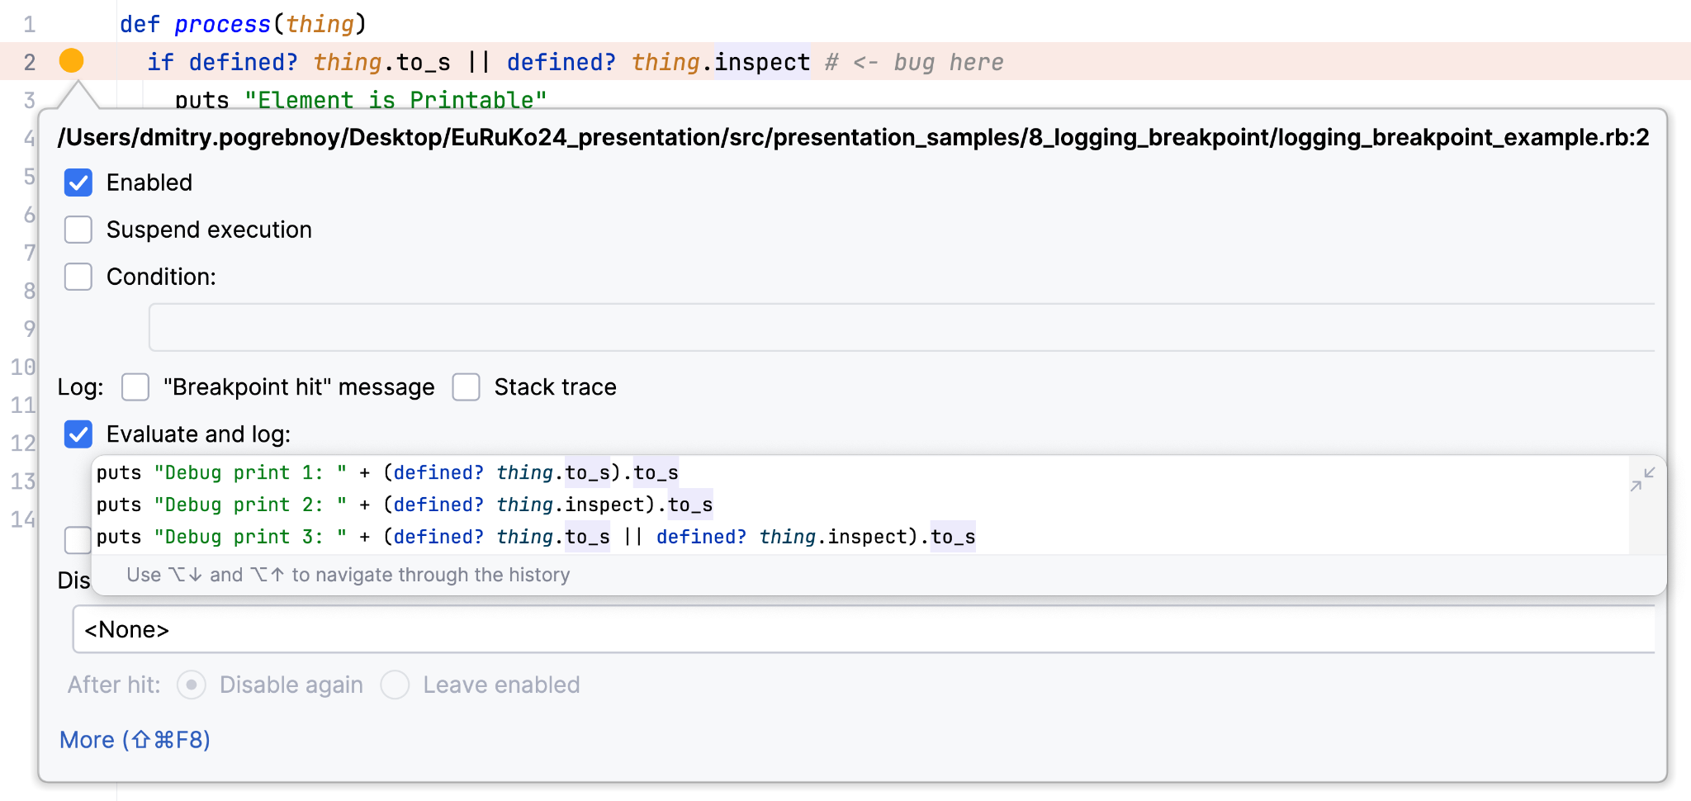
Logging Breakpoint
Shift + Right click on gutter
Notes:
This is a Picture with header and text slide that’s ideal for including picture with caption or brief descriptive statement.
To place the picture on this slide (this applies to all slides in this template that contain picture placeholders):
Click the white circle in the middle of the picture placeholder and select the insert option that best suits your needs.
Use the Crop tool to reposition the picture within the placeholder:
Right-click the picture placeholder, select Crop image. Click and drag the picture within the placeholder to reposition it.
To scale the picture within the placeholder (while Crop is active), grab a corner handle and drag it.
To keep the template design consistent, please paste text from another source using Paste without formatting (right-click or menu Edit).
Please take note that presentations are intended to help the audience focus on the speaker’s words rather than distract them with detailed reading material.
Each slide should use only a handful of words to reiterate the speaker's points, using imagery and text that reinforce the speaker’s point.
Avoid inserting so much text that you have to decrease the font size.

Slide 115
Logging Breakpoint
Shift + Right click on gutter
Notes:
This is a Picture with header and text slide that’s ideal for including picture with caption or brief descriptive statement.
To place the picture on this slide (this applies to all slides in this template that contain picture placeholders):
Click the white circle in the middle of the picture placeholder and select the insert option that best suits your needs.
Use the Crop tool to reposition the picture within the placeholder:
Right-click the picture placeholder, select Crop image. Click and drag the picture within the placeholder to reposition it.
To scale the picture within the placeholder (while Crop is active), grab a corner handle and drag it.
To keep the template design consistent, please paste text from another source using Paste without formatting (right-click or menu Edit).
Please take note that presentations are intended to help the audience focus on the speaker’s words rather than distract them with detailed reading material.
Each slide should use only a handful of words to reiterate the speaker's points, using imagery and text that reinforce the speaker’s point.
Avoid inserting so much text that you have to decrease the font size.

Slide 116
Logging Breakpoint
Notes:
This is a Picture with header and text slide that’s ideal for including picture with caption or brief descriptive statement.
To place the picture on this slide (this applies to all slides in this template that contain picture placeholders):
Click the white circle in the middle of the picture placeholder and select the insert option that best suits your needs.
Use the Crop tool to reposition the picture within the placeholder:
Right-click the picture placeholder, select Crop image. Click and drag the picture within the placeholder to reposition it.
To scale the picture within the placeholder (while Crop is active), grab a corner handle and drag it.
To keep the template design consistent, please paste text from another source using Paste without formatting (right-click or menu Edit).
Please take note that presentations are intended to help the audience focus on the speaker’s words rather than distract them with detailed reading material.
Each slide should use only a handful of words to reiterate the speaker's points, using imagery and text that reinforce the speaker’s point.
Avoid inserting so much text that you have to decrease the font size.

Slide 117


Thank you!
Dmitry Pogrebnoy
Connect me at linkedin.com/in/dmitrypogrebnoy
Try RubyMine Debugger!
Notes:
This is a Closing slide that is ideal for ending your presentation.
To keep the template design consistent, please paste text from another source using Paste without formatting (right-click or menu Edit).

Slide 118
Thank you!
1.
Try RubyMine Debugger
with 30-days trial!
Notes:
To keep the template design consistent, please paste text from another source using Paste without formatting (right-click or menu Edit).
Please take note that presentations are intended to help the audience focus on the speaker’s words rather than distract them with detailed reading material.
Each slide should use only a handful of words to reiterate the speaker’s points using text that reinforce the speaker’s point.
Avoid inserting so much text that you have to decrease the font size.
If your text does not fit in the text placeholder, consider breaking it into 2 slides or choosing a layout with 2 or 3 columns.

Slide 119
Thank you!
1.
2.
Try RubyMine Debugger
with 30-days trial!
Share your experience with me on LinkedIn!
Notes:
To keep the template design consistent, please paste text from another source using Paste without formatting (right-click or menu Edit).
Please take note that presentations are intended to help the audience focus on the speaker’s words rather than distract them with detailed reading material.
Each slide should use only a handful of words to reiterate the speaker’s points using text that reinforce the speaker’s point.
Avoid inserting so much text that you have to decrease the font size.
If your text does not fit in the text placeholder, consider breaking it into 2 slides or choosing a layout with 2 or 3 columns.

